Slide 1
One-Time Pads and Block Ciphers
CSE 405 Lecture 3
Notes:
FA23 note: The slides/website originally showed this schedule:
- Wed Sep 13: Lecture 6: Intro to Cryptography (Definitions, IND-CPA, One-Time Pads)
- Mon Sep 18: Lecture 7: Block Ciphers and Modes of Operation
We ended up spending more time on some topics, so the slides/website have been updated as of Sun Sep 24 to reflect what we did in live lecture:
- Wed Sep 13: Lecture 6: Intro to Cryptography (Definitions, IND-CPA)
- Mon Sep 18: Lecture 7: One-Time Pads and Block Ciphers
- Wed Sep 20: Lecture 8: Block Ciphers and Modes of Operation

Slide 2
Summary
What’s cryptography?
Communicating securely over insecure channels
You should never write your own crypto! Use existing libraries instead.
Definitions
Alice and Bob want to send messages over an insecure channel. Eve can read anything sent over the insecure channel. Mallory can read or modify anything sent over the insecure channel.
We want to ensure confidentiality (adversary can’t read message), integrity (adversary can’t modify message), and authenticity (prove message came from sender)
Crypto uses secret keys. Kerckhoff’s principle says to assume the attacker knows the entire system, except the secret keys.
There are several different threat models. We’ll focus on the chosen plaintext attack, where Eve tricks Alice into encrypting some messages.

Slide 3
Summary
IND-CPA security
Even if Eve can trick Alice into encrypting some messages of Eve’s choosing, given the encryption of either M0 or M1, Eve cannot distinguish which message was sent with probability greater than 1/2.
We can use the IND-CPA game to test for IND-CPA security
Edge cases: IND-CPA secure schemes can leak length. Eve is limited to polynomial-time algorithms, and must have a non-negligible advantage to win.

Slide 4
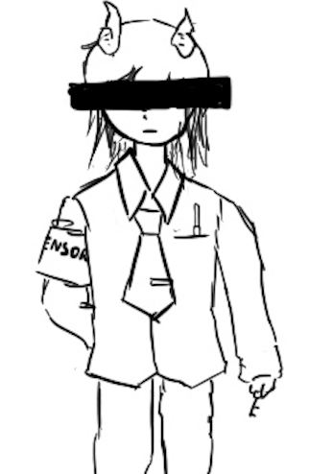
One-Time Pads
Textbook Chapter 6.2 & 6.3

Slide 5
Cryptography Roadmap
 | Symmetric-key | Asymmetric-key
Confidentiality | One-time pads Block ciphers with chaining modes (e.g. AES-CBC) Stream ciphers | RSA encryption ElGamal encryption
Integrity, Authentication | MACs (e.g. HMAC) | Digital signatures (e.g. RSA signatures)
Hash functions
Pseudorandom number generators
Public key exchange (e.g. Diffie-Hellman)
Key management (certificates)
Password management

Slide 6
Review: XOR
The XOR operator takes two bits and outputs one bit:
Useful properties of XOR:
0 ⊕ 0 = 0
0 ⊕ 1 = 1
1 ⊕ 0 = 1
1 ⊕ 1 = 0
x ⊕ 0 = x
x ⊕ x = 0
x ⊕ y = y ⊕ x
(x ⊕ y) ⊕ z = x ⊕ (y ⊕ z)
(x ⊕ y) ⊕ x = y

Slide 7
Review: XOR Algebra
Algebra works on XOR too
y ⊕ 1 = 0 | Goal: Solve for y
y ⊕ 1 ⊕ 1 = 0 ⊕ 1 | XOR both sides by 1
y = 1 | Simplify with identities

Slide 8
One-Time Pads: Key Generation
Alice
K
0 | 1 | 1 | 0 | 0 | 1 | 0 | 1 | 0 | 1 | 1 | 1
The key K is a randomly-chosen bitstring.
Recall: We are in the symmetric-key setting, so we’ll assume Alice and Bob both know this key.

Slide 9
One-Time Pads: Encryption
Alice
K
0 | 1 | 1 | 0 | 0 | 1 | 0 | 1 | 0 | 1 | 1 | 1
M
1 | 0 | 0 | 1 | 1 | 0 | 0 | 1 | 0 | 1 | 0 | 0
The plaintext M is the bitstring that Alice wants to encrypt.
Idea: Use XOR to scramble up M with the bits of K.

Slide 10
One-Time Pads: Encryption
Alice
K
0 | 1 | 1 | 0 | 0 | 1 | 0 | 1 | 0 | 1 | 1 | 1
⊕ | ⊕ | ⊕ | ⊕ | ⊕ | ⊕ | ⊕ | ⊕ | ⊕ | ⊕ | ⊕ | ⊕
M
1 | 0 | 0 | 1 | 1 | 0 | 0 | 1 | 0 | 1 | 0 | 0
↓ | ↓ | ↓ | ↓ | ↓ | ↓ | ↓ | ↓ | ↓ | ↓ | ↓ | ↓
C
1 | 1 | 1 | 1 | 1 | 1 | 0 | 0 | 0 | 0 | 1 | 1
Encryption algorithm: XOR each bit of K with the matching bit in M.
The ciphertext C is the encrypted bitstring that Alice sends to Bob over the insecure channel.

Slide 11
One-Time Pads: Decryption
Bob
K
0 | 1 | 1 | 0 | 0 | 1 | 0 | 1 | 0 | 1 | 1 | 1
C
1 | 1 | 1 | 1 | 1 | 1 | 0 | 0 | 0 | 0 | 1 | 1
Bob receives the ciphertext C. Bob knows the key K. How does Bob recover M?

Slide 12
One-Time Pads: Decryption
Bob
K
0 | 1 | 1 | 0 | 0 | 1 | 0 | 1 | 0 | 1 | 1 | 1
⊕ | ⊕ | ⊕ | ⊕ | ⊕ | ⊕ | ⊕ | ⊕ | ⊕ | ⊕ | ⊕ | ⊕
C
1 | 1 | 1 | 1 | 1 | 1 | 0 | 0 | 0 | 0 | 1 | 1
↓ | ↓ | ↓ | ↓ | ↓ | ↓ | ↓ | ↓ | ↓ | ↓ | ↓ | ↓
M
1 | 0 | 0 | 1 | 1 | 0 | 0 | 1 | 0 | 1 | 0 | 0
Decryption algorithm: XOR each bit of K with the matching bit in C.

Slide 13
One-Time Pad
KeyGen()
Randomly generate an n-bit key, where n is the length of your message
Recall: For today, we assume that Alice and Bob can securely share this key
For one-time pads, we generate a new key for every message
Enc(K, M) = K ⊕ M
Bitwise XOR M and K to produce C
In other words: XOR the ith bit of the plaintext with the ith bit of the key.
Ci = Ki ⊕ Mi
Alice and Bob use a different key for each encryption (this is the “one-time” in one-time pad).
Dec(K, C) = K ⊕ C
Bitwise XOR C and K to produce M
Mi = Ki ⊕ Ci
Notes:
Ask students if they can produce the decryption equation before showing it to them

Slide 14
One-Time Pad: Correctness
Correctness: If we encrypt and then decrypt, we should get the original message back
Enc(K, M) | = | K ⊕ M | Definition of encryption
Dec(K, Enc(K, M)) | = | Dec(K, K ⊕ M) | Decrypting the ciphertext
 | = | K ⊕ (K ⊕ M) | Definition of decryption
 | = | M | XOR property

Slide 15
One-Time Pad: Security
Recall our definition of confidentiality: The ciphertext should not give the attacker any additional information about the plaintext
Recall our experiment to test confidentiality from earlier:
Alice has encrypted and sent either M0 or M1
Eve knows either M0 or M1 was sent, but doesn't know which
Eve reads the ciphertext and tries to guess which message was sent
If the probability that Eve correctly guesses which message was sent is 1/2, then the encryption scheme is confidential

Slide 16
One-Time Pad: Security
Possibility 0: Alice sends Enc(K, M0)
Possibility 1: Alice sends Enc(K, M1)
The ciphertext is C = K ⊕ M0
Therefore, K = C ⊕ M0
The ciphertext is C = K ⊕ M1
Therefore, K = C ⊕ M1
K was chosen randomly, so both possibilities are equally possible
Eve has learned no new information, so the scheme is perfectly secure

Slide 17
Two-Time Pads?
Alice
K
Insecure Channel
M0
OTP Enc
K ⊕ M0
Eve sees two ciphertexts over the insecure channel.
K
M1
OTP Enc
K ⊕ M1
What if we use the same key K to encrypt two different messages?

Slide 18
Two-Time Pads?
Alice
K
Insecure Channel
Eve
M0
OTP Enc
K ⊕ M0
(K ⊕ M0) ⊕ (K ⊕ M1) = M0 ⊕ M1
K
⊕
M1
OTP Enc
K ⊕ M1
If Eve XORs the two ciphertexts, she learns M0 ⊕ M1!

Slide 19
Two-Time Pads?
What if we use the same key twice?
Alice encrypts M0 and M1 with the same key
Eve observes K ⊕ M0 and K ⊕ M1
Eve computes (K ⊕ M0) ⊕ (K ⊕ M1) = M0 ⊕ M1
Recall the XOR property: the K's cancel out
Eve has learned M0 ⊕ M1. This is partial information about the messages!
In words, Eve knows which bits in M0 match bits in M1
If Eve knows M0, she can deduce M1 (and vice-versa)
Eve can also guess M0 and check that M1 matches her guess for M0
Result: One-time pads are not secure if the key is reused
Alice and Bob must use a different key for every message!

Slide 20
Impracticality of One-Time Pads
Problem #1: Key generation
For security to hold, keys must be randomly generated for every message, and never reused
Randomness is expensive, as we’ll see later
Problem #2: Key distribution
To communicate an n-bit message, we need to securely communicate an n-bit key first
But if we have a way to securely communicate an n-bit key, we could have communicated the message directly!
Only practical application: Communicate keys in advance
You have a secure channel now, but you won’t have it later
Use the secure channel now to communicate keys in advance
Use one-time pad later to communicate over the insecure channel
And people can compute this by hand without computers!

Slide 21
One-Time Pads in Practice: Spies
At home base, the spy obtains a large amount of key material (e.g. a book of random bits)
In the field, the spy listens for secret messages from their home country
There are shortwave and terrestrial radio “number stations”
At a regular time, a voice gets on the air and reads a series of numbers
If you don’t know the key, this looks like a meaningless sequence of random numbers
If you know the key, you can decrypt the spy message!
What if you don’t want to send anything to any spies?
Read out a list of random numbers anyway
Because one-time pad leaks no information, an eavesdropper can’t distinguish between an encrypted message and random numbers!

Slide 22
Two-Time Pads in Practice: VENONA
Soviet spies used one-time pads for communication from their spies in the US
During WWII, the Soviets started reusing key material
Uncertain whether it was just the cost of generating pads or what…
VENONA was a US cryptanalysis project designed to break these messages
Included confirming/identifying the spies targeting the US Manhattan project
Project continued until 1980!
Not declassified until 1995!
So secret even President Truman wasn’t informed about it
The Soviets found out about it in 1949 through their spy Ken Philby, but their one-time pad reuse was fixed after 1948 anyway
Takeaway: Otherwise-secure cryptographic systems can fail very badly if used improperly!
Notes:
TODO Nick

Slide 23
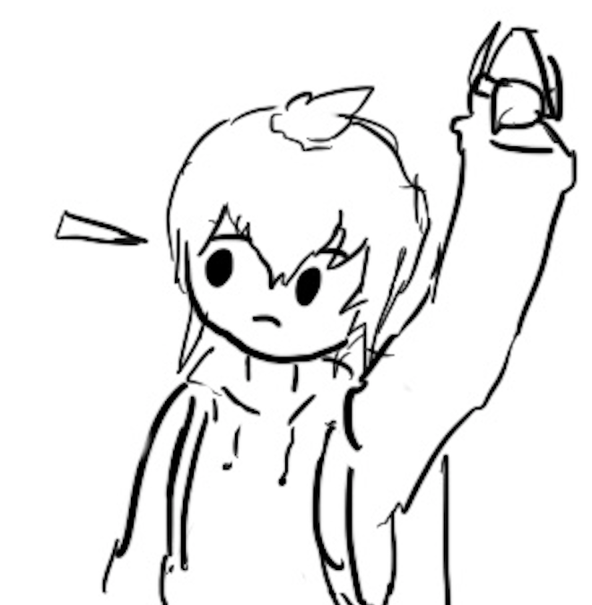
Block Ciphers
Textbook Chapter 6.4 & 6.5

Slide 24
Cryptography Roadmap
 | Symmetric-key | Asymmetric-key
Confidentiality | One-time pads Block ciphers with chaining modes (e.g. AES-CBC) Stream ciphers | RSA encryption ElGamal encryption
Integrity, Authentication | MACs (e.g. HMAC) | Digital signatures (e.g. RSA signatures)
Hash functions
Pseudorandom number generators
Public key exchange (e.g. Diffie-Hellman)
Key management (certificates)
Password management

Slide 25
Block Ciphers: Definition
plaintext
Block cipher: An encryption/decryption algorithm that encrypts a fixed-sized block of bits
EK(M) → C: Encryption
Inputs: k-bit key K and an n-bit plaintext M
Output: An n-bit ciphertext C
Sometimes written as: {0, 1}^{k} × {0, 1}^{n} → {0, 1}^{n}
DK(C) → M: Decryption
Inputs: a k-bit key, and an n-bit ciphertext C
Output: An n-bit plaintext
Sometimes written as: {0, 1}^{k} × {0, 1}^{n} → {0, 1}^{n}
The inverse of the encryption function
Properties
Correctness: EK is a permutation, DK is its inverse
Efficiency: Encryption/decryption should be fast
Security: E behaves like a random permutation
n bits
K
k bits
E
n bits
ciphertext
ciphertext
n bits
K
k bits
D
n bits
plaintext

Slide 26
Block Ciphers: Correctness
EK(M) must be a permutation (bijective function) on n-bit strings
Each input must correspond to exactly one unique output
Intuition
Suppose EK(M) is not bijective
Then two inputs might correspond to the same output: E(K, x1) = E(K, x2) = y
Given ciphertext y, you can’t uniquely decrypt. D(K, y) = x1? D(K, y) = x2?
00
01
10
11
00
01
10
11
00
01
10
11
00
01
10
11
Not bijective: Two inputs encrypt to the same output
Bijective: Each input maps to exactly one unique output

Slide 27
Block Ciphers: Security
A secure block cipher behaves like a randomly chosen permutation from the set of all permutations on n-bit strings
A random permutation: Each n-bit input is mapped to one randomly-chosen n-bit output
Defined by a distinguishing game
Eve gets two boxes: One is a randomly chosen permutation, and one is EK with a randomly chosen key K
Eve should not be able to tell which is which with probability > 1/2
00
01
10
11
00
01
10
11
00
01
10
11
00
01
10
11
One of these is EK with a randomly chosen K, and the other one is a randomly chosen permutation. Eve can’t distinguish them.

Slide 28
Block ciphers: Brute-force attacks?
How hard is it to run a brute-force attack on a 128-bit key?
We have to try 2¹²⁸ possibilities. How big is 2¹²⁸?
Handy approximation: 2¹⁰ ≈ 10³
2¹²⁸ = 2^{10*12.8} ≈ (10³)^{12.8} ≈ (10³)¹³ = 10³⁹
Suppose we have massive hardware that can try 10⁹ (1 billion) keys in 1 nanosecond (a billionth of a second). That’s 10¹⁸ keys per second
We’ll need 10³⁹ / 10¹⁸ = 10²¹ seconds. How long is that?
One year ≈ 3×10⁷ seconds
10²¹ seconds / 3×10⁷ ≈ 3×10¹³ years ≈ 30 trillion years
Takeaway: Brute-forcing a 128-bit key takes astronomically long. Don’t even try.

Slide 29
Block ciphers: Brute-force attacks?
How hard is it to run a brute-force attack on a 256-bit key in the same time?
We need 10⁵² of the brute-force devices from before
If each brute-force device from before is 1 cubic millimeter, this would take 10⁴³ cubic meters of space
That’s the volume of 7×10¹⁵ suns!
For reference, the Milky Way galaxy has just 10¹¹ stars
Takeaway: Brute-force attacks on modern block ciphers are not possible, assuming the key is random and secret
128-bit key? Definitely not happening.
256-bit key? Lol no.

Slide 30
Block Ciphers: Efficiency
Encryption and decryption should be computable in microseconds
Formally: KeyGen(), Enc(), and Dec(), should not take exponential time
Block cipher algorithms typically use operations like XOR, bit-shifting, and small table lookups
Very fast on modern processors
Modern CPUs provide dedicated hardware support for block ciphers
Notes:
TODO This should be E and D, not KeyGen, Enc, and Dec

Slide 31
DES (Data Encryption Standard)
Designed in late 1970s
Block size 64 bits (n = 64)
Key size 56 bits (k = 56)
NSA influenced two facets of its design
Altered some subtle internal workings in a mysterious way
Reduced key size from 64 bits to 56 bits
Made brute force attacks feasible for an attacker with massive computational resources (by 1970s standards)
The algorithm remains essentially unbroken 40 years later
The NSA’s tweaking hardened it against an attack publicly revealed a decade later
However, modern computer speeds make it completely unsafe due to small key size
~6.4 × 10¹⁶, say 10¹⁰ tries per second on my single desktop computer's Nvidia graphics card: Takes ~6.4 × 10⁶ seconds or ~70 days

Slide 32
AES (Advanced Encryption Standard)
1997–2000: NIST (National Institute of Standards and Technology) in the US held a competition to pick a new block cipher standard
One of the finalists, Twofish, was designed by Berkeley professor and occasional CS 161 instructor David Wagner!
Out of the 5 finalists:
Rijndael, Twofish, and Serpent had really good performance
RC6 had okay performance
Mars had ugly performance
On any given computing platform, Rijndael was never the fastest
But on every computing platform, Rijndael was always the second-fastest
Twofish and Serpent each had at least one compute platform they were bad at
Rijndael was selected as the new block cipher standard

Slide 33
AES (Advanced Encryption Standard)
Key size 128, 192, or 256 bits (k = 128, 192, or 256)
Actual cipher names are AES-128, AES-192, and AES-256
Paranoid people like the NSA use AES-256 keys, but AES-128 is just fine in practice
Block size 128 bits (n = 128)
Note: The block size is still always 128 bits, regardless of key size
You don’t need to know how AES works, but you do need to know its parameters
here’s a comic

Slide 34
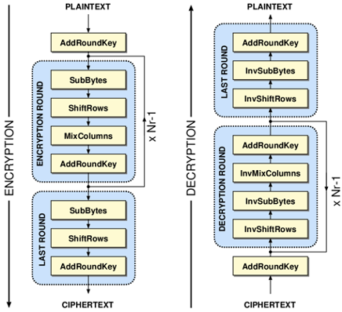
AES Algorithm
Different key sizes use different numbers of rounds
10 rounds for 128-bit keys
12 rounds for 192-bit keys
14 rounds for 256-bit keys
Each round uses its own “round key” derived from the cipher key
Each round:
SubBytes()
ShiftRows()
MixColumns() (if not last round)
AddRoundKey()
Notes:
AES slides, credit Kevin Orr

Slide 35
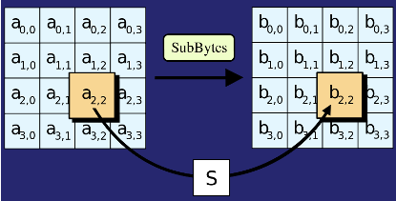
AES Algorithm: SubBytes()
Replace each byte in the block with another byte using an 8-bit substitution box

Slide 36
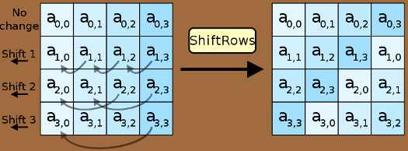
AES Algorithm: ShiftRows()
Cyclically shifts the bytes in each row by a certain offset
The number of places each byte is shifted differs for each row

Slide 37
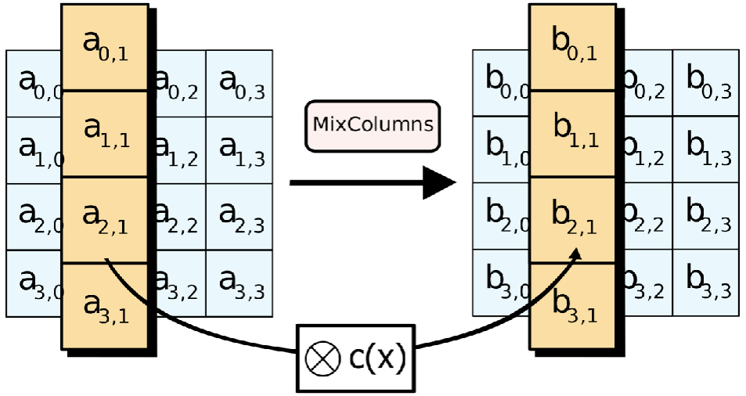
AES Algorithm: MixColumns()
Treats the 16-byte block as a 4 × 4 matrix and multiply it by by another matrix

Slide 38
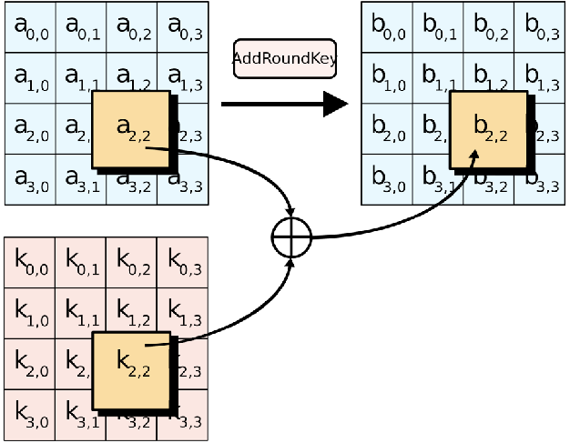
AES Algorithm: AddRoundKey()
XOR the 16-byte block with the 16-byte round key

Slide 39
AES (Advanced Encryption Standard)
There is no formal proof that AES is secure (indistinguishable from a random permutation)
However, in 20 years, nobody has been able to break it, so it is assumed to be secure
The NSA uses AES-256 for secrets they want to keep secure for the 40 years (even in the face of unknown breakthroughs in research)
Takeaway: AES is the modern standard block cipher algorithm
The standard key size (128 bits) is large enough to prevent brute-force attacks

Slide 40
Are Block Ciphers IND-CPA Secure?
Eve (adversary)
Alice (challenger)
Consider the following adversary:
Eve sends two different messages M0 and M1
Eve receives either EK(M0) or EK(M1)
Eve requests the encryption of M0 again
Strategy: If the encryption of M0 matches what she received, guess b = 0. Else, guess b = 1.
Eve can win the IND-CPA game with probability 1!
Block ciphers are not IND-CPA secure
M
(repeat)
Enc(K, M)
M0 and M1
pick b
Enc(K, Mb)
M
(repeat)
Enc(K, M)
Guess b = 0 or b = 1

Slide 41
Issues with Block Ciphers
Block ciphers are not IND-CPA secure, because they’re deterministic
A scheme is deterministic if the same input always produces the same output
No deterministic scheme can be IND-CPA secure because the adversary can always tell if the same message was encrypted twice
Block ciphers can only encrypt messages of a fixed size
For example, AES can only encrypt-decrypt 128-bit messages
What if we want to encrypt something longer than 128 bits?
To address these problems, we’ll add modes of operation that use block ciphers as a building block!
Notes:
Ask for any other issues students can think of after describing deterministic schemes

Slide 42
Summary: One-Time Pads
One-time pads
Symmetric encryption scheme: Alice and Bob share a secret key.
Encryption and decryption: Bitwise XOR with the key.
No information leakage if the key is never reused.
Information leaks if the key is reused.
Impractical for real-world usage, unless you’re a spy.

Slide 43
Summary: Block Ciphers
Encryption: input a k-bit key and n-bit plaintext, receive n-bit ciphertext
Decryption: input a k-bit key and n-bit ciphertext, receive n-bit plaintext
Correctness: when the key is fixed, EK(M) should be bijective
Security
Without the key, EK(m) is computationally indistinguishable from a random permutation
Brute-force attacks take astronomically long and are not possible
Efficiency: algorithms use XORs and bit-shifting (very fast)
Implementation: AES is the modern standard
Issues
Not IND-CPA secure because they’re deterministic
Can only encrypt n-bit messages

